Slide 1
Model Building(11-dars)
Davronbek Malikov

Slide 2

Bugun
Savol javob
Model Improve yo’llari
Ensemble Methods
Ensemble Methods: Amaliy
Nimalar o’rgandik
Project (12-dars)
Vazifa

Slide 3
Takrorlash

Slide 4

Takrorlash
Savol javob
Model Improvement review?
Feature Selection va uning turlari
Amaliy xar biri bo’yicha
Vazifa

Slide 5

Model Improvement review

Slide 6
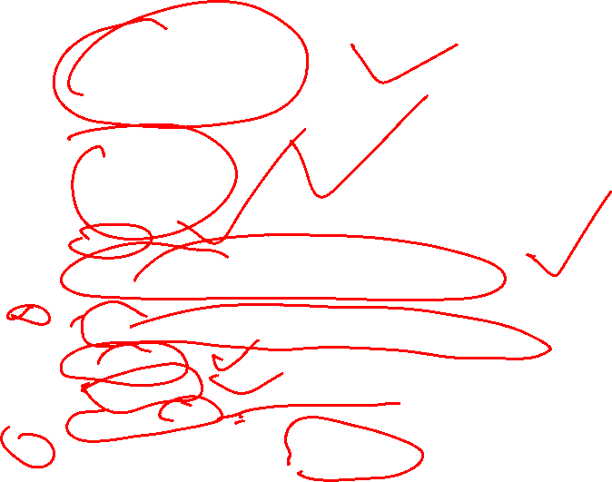
Model Imrovement yo’llari
Data Quality and Quantaty
Ko’proq dataset collection
Datasetni tozalang
Feature Engineering
Yangi Featurelar yarating
Transform features
Domain knowledge
Feature Selection
Scaling
Turli xil algorithmlar bn tekshiri
Bazi xollarda sodaroq algorithmlar xam yuqori natija beradi
Hyperparametr tuning
Bizning algorithm va datasetga mos paramaterlarni topish jarayoni
Cross validation
Regulararization
Ensemble Methods
Handling Imbanced Dataset (Classification)

Slide 7

Ensemble Methods

Slide 8

Ensemble Methods
ML technique
Bir nechta kuchsiz modellarni birlashtirish orqali modelni rivojlantirish
Asosiy logika: Ko’plab kuchsiz algorithms kuchli model xosil qiladi

Slide 9

Ensemble Methods
Nima uchun ishlatamiz:
Reduce variance → handle overfitting (e.g., bagging).
Reduce bias → improve weak learners (e.g., boosting).
Improve accuracy → aggregate multiple perspectives.
Increase robustness → less sensitive to noise.

Slide 10

Ensemble Methods: Turlari
Bagging(Boostraping)
Boosting
Stacking
Voting

Slide 11
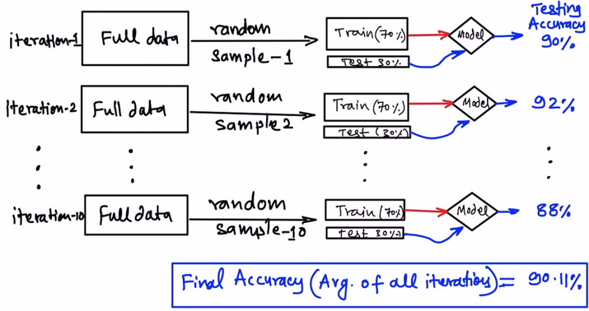
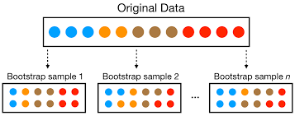
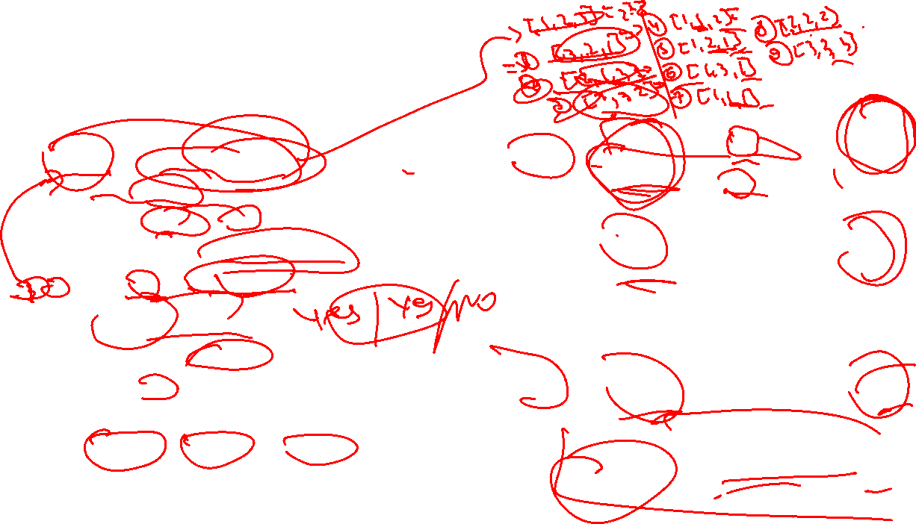
Ensemble Methods: Turlari
Bagging(Bootstraping):
Train multiple
Result: Voting/avg
Algorithm: Random Forest
Bir xil len, tushib qolish va
qaytalanish normal

Slide 12
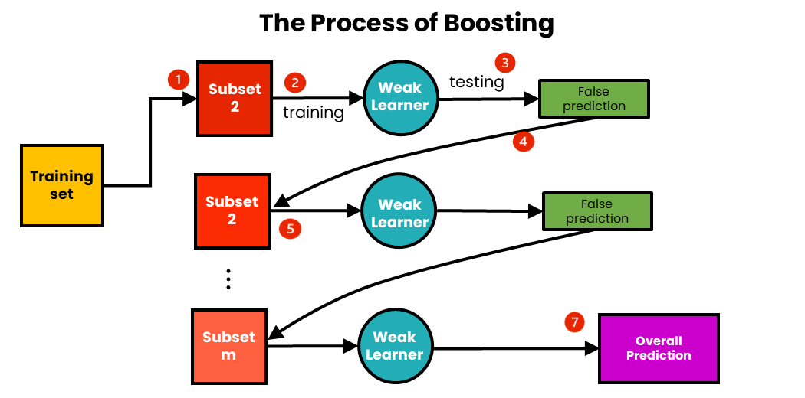
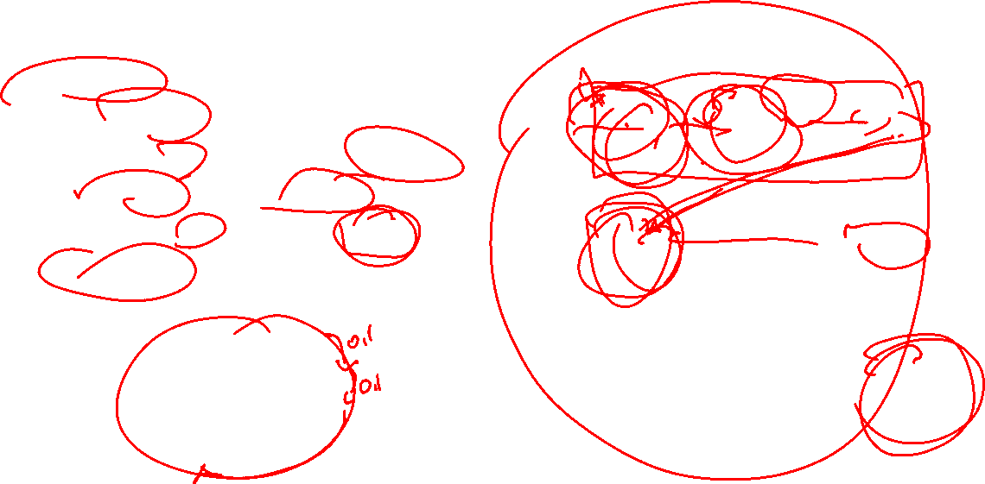
Ensemble Methods: Turlari
Boosting:
Train ketma ket
Xar bir model oldingisini togrilaydi
Yakuniy model=sum(kuchsiz)
Algorithm: GBM,Adaboost,XGB
Full dataset

Slide 13
Ensemble Methods: Amaliy

Slide 14
Nimalar o’rgandik
SML
Python
Turli xil algorithmlar:
Ridge
Lasso
xGBoost
Feature Engineering
Yangi featurelar yaratish
Feature transform
Feature selection
Ensemble methods
Bagging(Bootstraping)
Boosting
2 ta Project
Built-in functions
Classes
Files

Slide 15
Project (12-dars)

Slide 16

Project (12-dars)
Project xolati:15
Ximoya: 35
Muddati: Juma kuni soat 19:00
Ximoya kuni: Shanba soat 19:15

